Slide 1


Geography
Extreme Earth
Year One
Geography | Year 3 | Extreme Earth | Tsunamis | Lesson 5

Slide 3
Aim
I can explain what causes tsunamis and how they affect people.
Success Criteria
I can tell you where tsunamis happen.
I can explain what causes a tsunami.
I can describe the damage caused by a tsunami.
I can tell you how to keep safe in a tsunami.

Slide 4







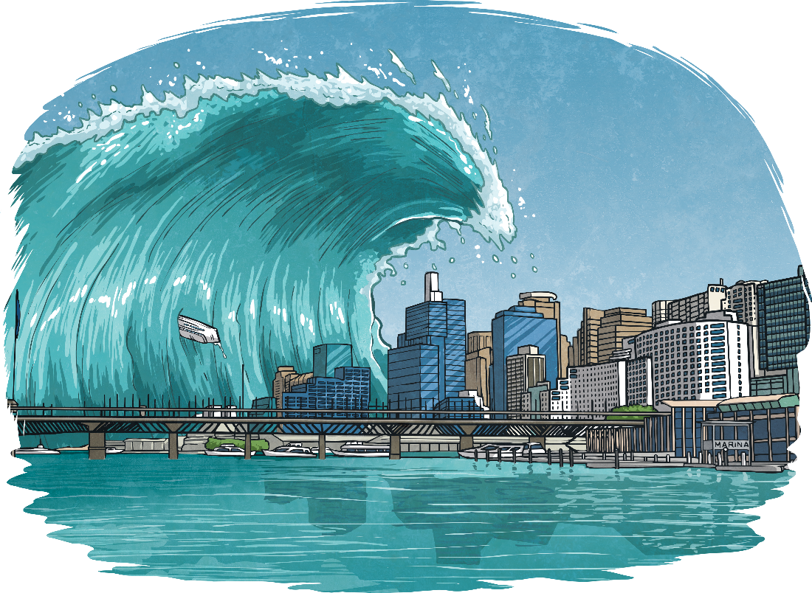
What Is a Tsunami?
What do you think a tsunami is?
Tsunami is a
Japanese word.
It means
‘Harbour Wave’.
A tsunami is a
giant wave.
Was your idea close to the real meaning?

Slide 5
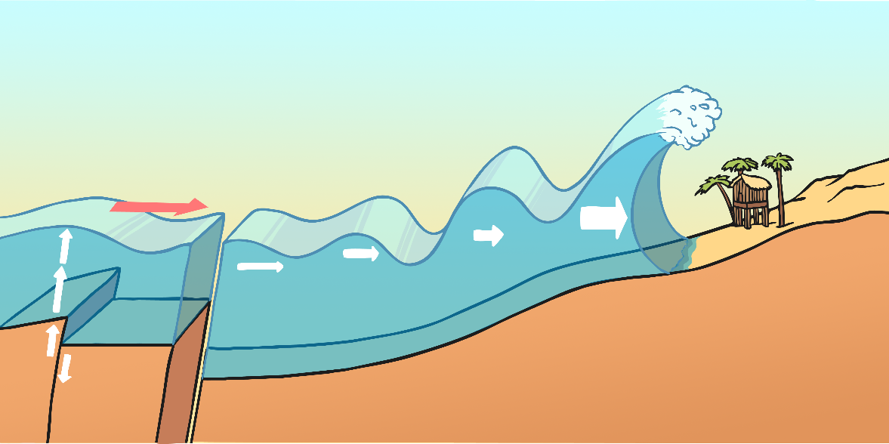
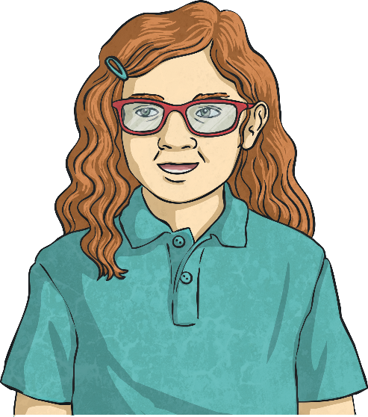
What Causes a Tsunami?
A tsunami is a giant wave caused by a huge earthquake under the ocean.
The earthquake causes a large amount of water to be displaced very quickly.
A series of waves travels through the deep water.
As the waves travel through shallower water near the land, they get bigger.
Did you know… before the tall wave hits the land, the water level at the
shore will drop?

Slide 6
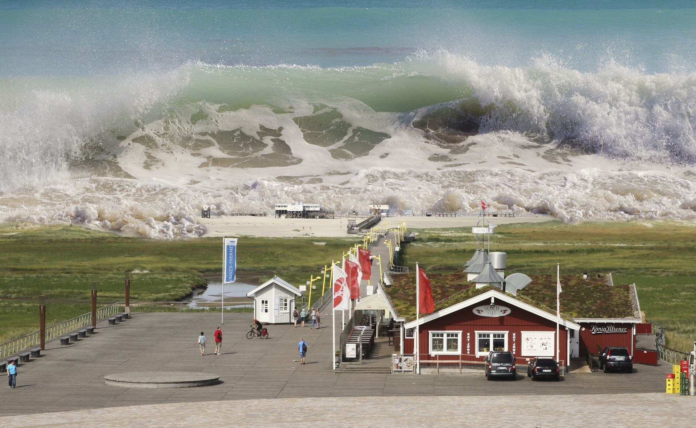
What Causes a Tsunami?

Slide 7
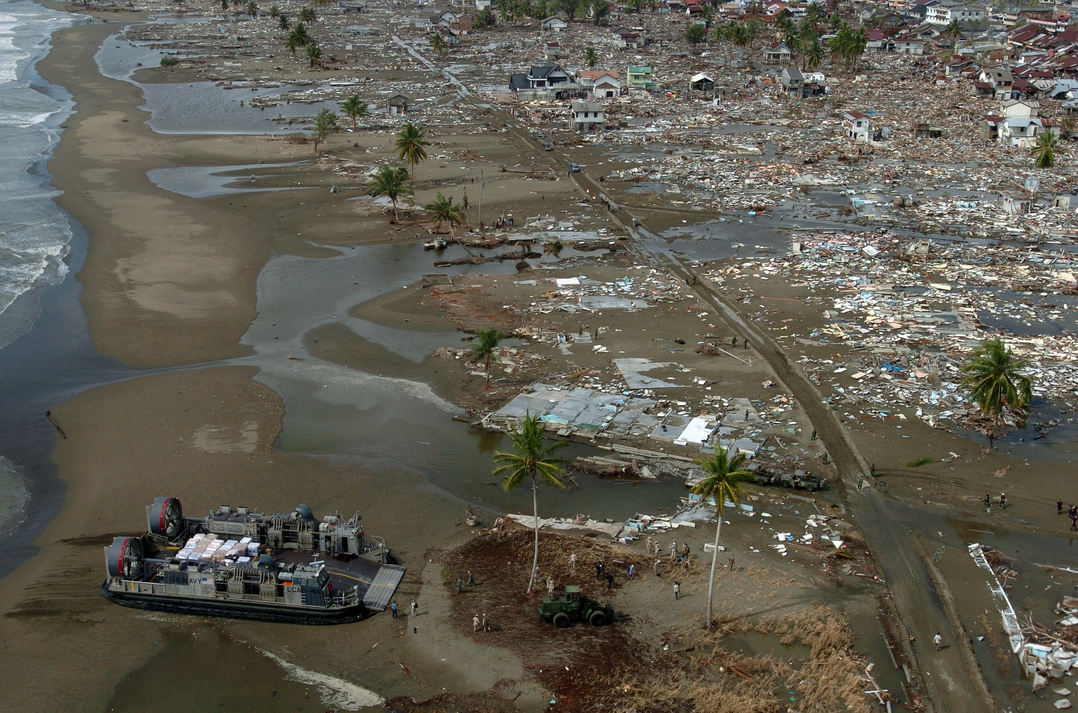
What Damage Does
a Tsunami Cause?
What can you see that looks out of place?
What kinds of damage have occurred in the area?
If you were in a rescue team who have just arrived at the scene, what kinds of help might you need to give?

Slide 8
What Damage Does
a Tsunami Cause?
Tell the rest of the group what you noticed in your picture.
Are there things the same in all of the pictures?
What differences are there?
What help would people affected need now and in the future?

Slide 9
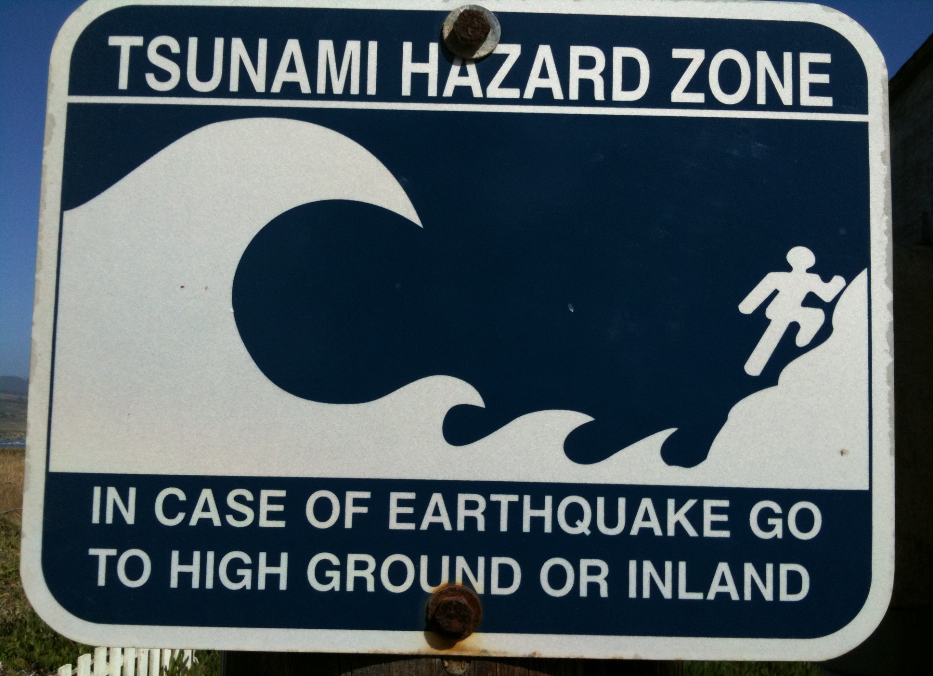

Slide 10

Tsunami Safety Rules
Approaching tsunamis are sometimes predicted by a sudden rise or fall of coastal waters and are usually accompanied by a loud roar that sounds like a train or aircraft. If you notice these, move inland to high ground straight away.
Homes and other buildings located in low lying coastal areas are not safe. Do NOT stay in such buildings if there is a tsunami warning.
Stay out of danger until an "ALL CLEAR" is issued by the emergency services.
The upper floors of high, multi-story, reinforced concrete hotels can provide safety if there is no time to quickly move inland or to higher ground.
Never go down to the beach to watch for a tsunami! A small tsunami at one beach can be a giant a few miles away.
Stay tuned to your local radio or television stations during a tsunami emergency.

Slide 11
Aim
I can explain what causes tsunamis and how they affect people.
Success Criteria
I can tell you where tsunamis happen.
I can explain what causes a tsunami.
I can describe the damage caused by a tsunami.
I can tell you how to keep safe in a tsunami.

