Slide 1
Geography
Extreme Earth
Year One
Geography | Year 3 | Extreme Earth | Tornadoes | Lesson 6

Slide 3
Aim
To explain what causes tornadoes and the effects they have.
Success Criteria
I can tell you how tornadoes form.
I can explain how scientists collect data about storms.
I can explain how scientists compare tornadoes.
I can tell you where tornadoes happen.

Slide 4
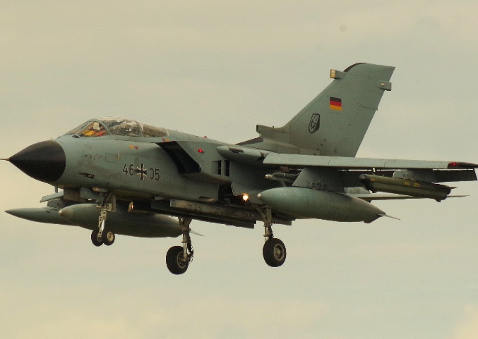
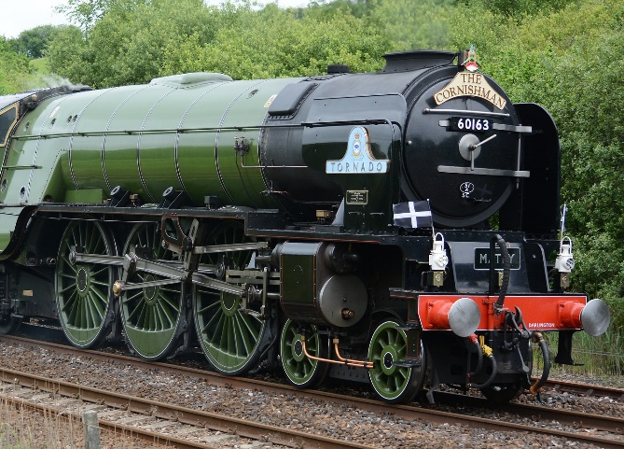
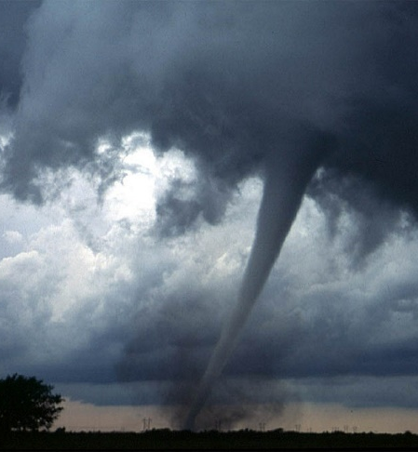
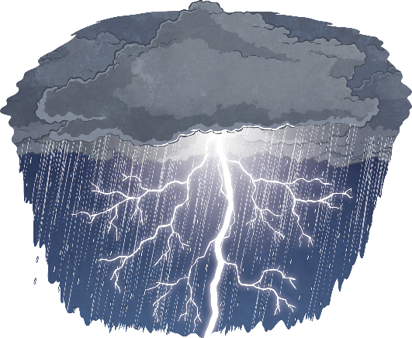
What Is a Tornado?
A tornado is a swirling funnel of air that can come down from some of the biggest clouds, called Cumulonimbus.
At the same time, there can be thunder and lightning.

Slide 5
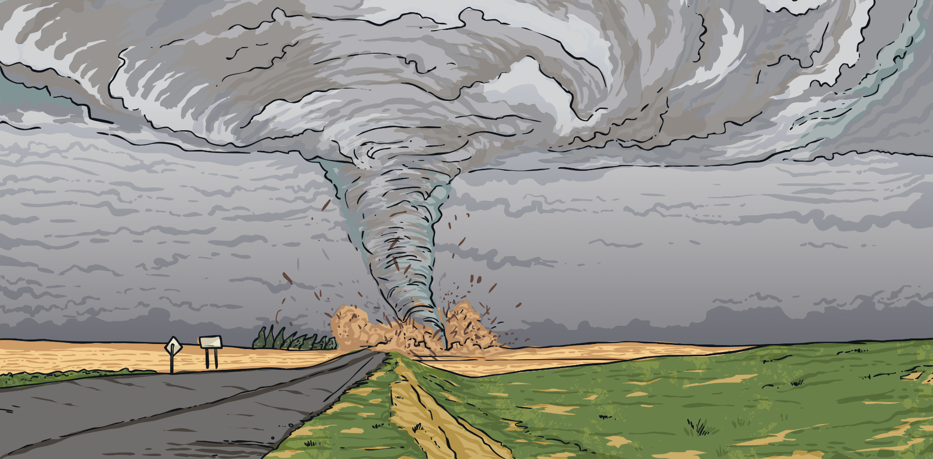
How Do Tornadoes Form?
Tornadoes form when warm air rises up from near the ground into big cumulonimbus (thunderstorm) clouds.
The winds high up near the tops of the storm clouds start rotating.
The rotating air is called a vortex.
More air flows in along the ground from all directions and the vortex moves downwards and becomes more narrow.
Funnel clouds form and develop into tornadoes.
You can see tornadoes because of the water droplets and dust caught up in them.

Slide 6
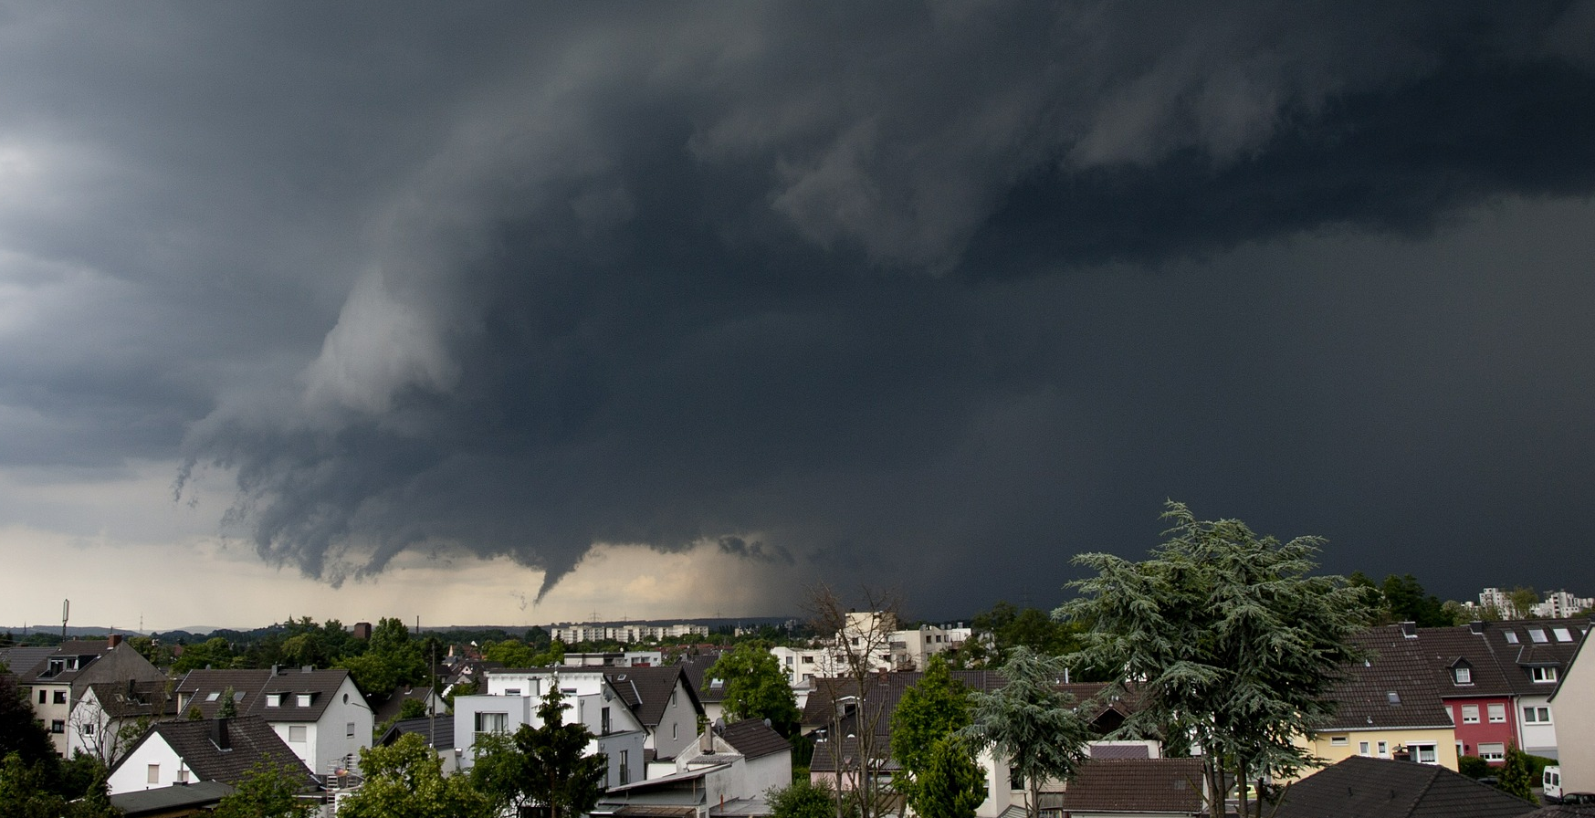
What Causes a Tornado?
Watch this animation which shows how tornadoes are formed.

Slide 7
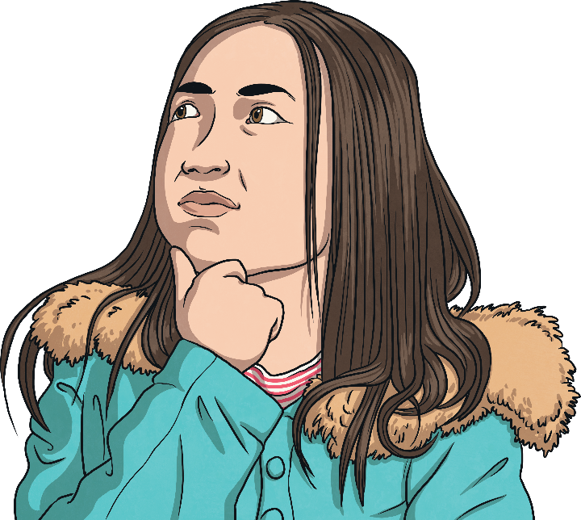
How Do Tornadoes Form?
Watch what happens inside the bottle.
What did you notice?
If the bottles are rotated slightly, does the same thing happen?
What did you see?
How could we make the vortex spin more quickly?

Slide 8
How Do Scientists Collect Data
About Tornadoes?
Watch this Storm Chasers video. Storm Chasers are film makers and scientists who head into storms to film tornadoes. They film as the tornadoes form and collect data about what is happening.
What did you notice about the equipment they used?
How was it suited to the job?
Photo courtesy of minds-eye (@flickr.com) – granted under creative commons licence - attribution

Slide 9
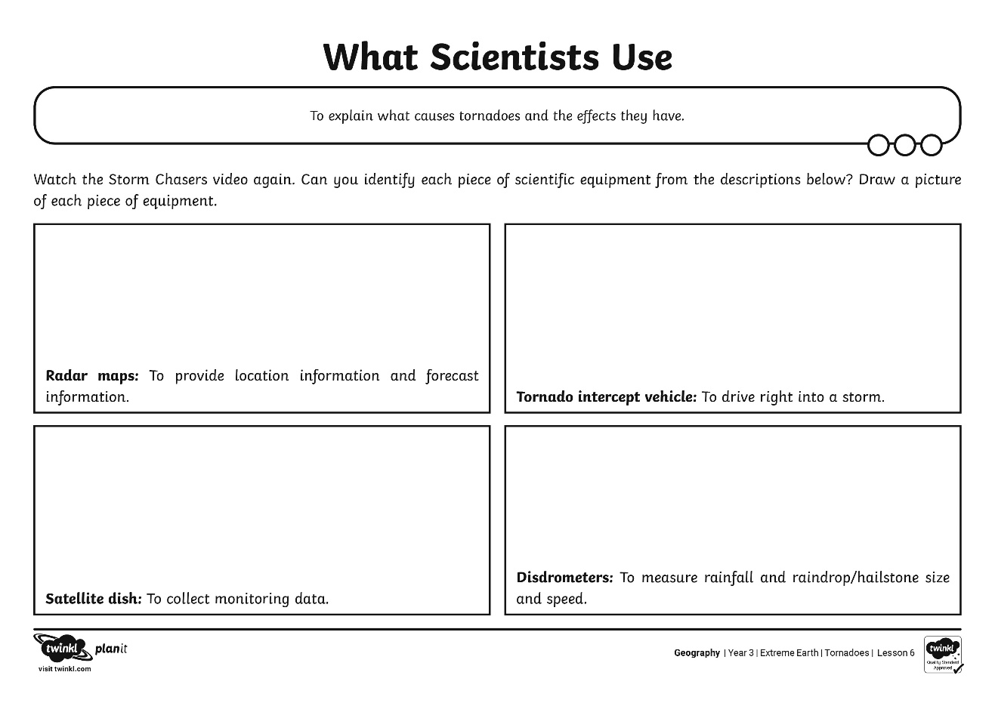
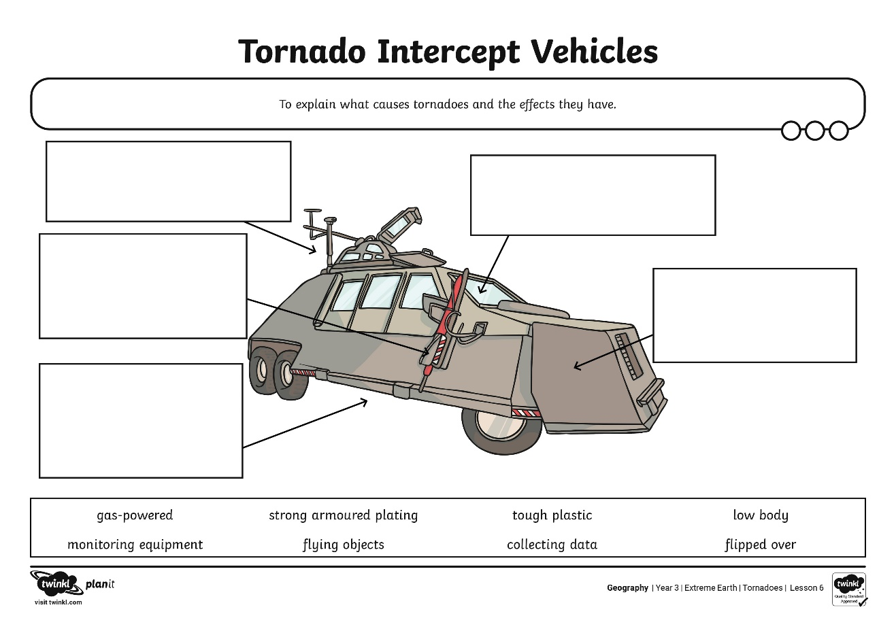
What Do Scientists Use?

Slide 10
How Do Scientists Compare Tornadoes?
EF Level | Wind Speed | Damage Profile
EF0 | 40-72 MPH | Minor Damage: Some damage to chimneys, branches break off trees, shallow-rooted trees are pushed over and sign boards are damaged.
EF1 | 73-112 MPH | Moderate Damage: Surface of roofs are blown off, mobile homes are pushed off foundations or overturned and moving cars pushed off the roads.
EF2 | 113-157 MPH | Considerable Damage: Roofs are torn off houses, mobile homes are demolished, large trees are snapped or uprooted and light objects fly through the air.
EF3 | 158-206 MPH | Critical Damage: Roofs and some walls are torn off well-constructed houses; trains are overturned, most trees are uprooted and heavy cars are lifted into the air and thrown.
EF4 | 207-260 MPH | Severe Damage: Well-constructed houses are demolished, structures with weak foundations are blown some distance, cars are thrown and large objects fly through the air.
EF5 | 261-318 MPH | Total Destruction: Strong framed houses are lifted off foundations and carried considerable distances, large objects such as cars and trees fly through the air and steel-reinforced concrete structures are badly damaged.

Slide 11
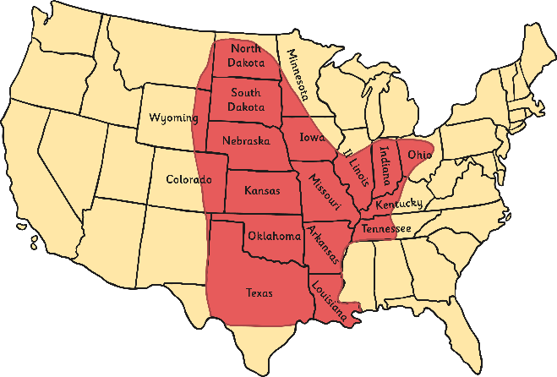
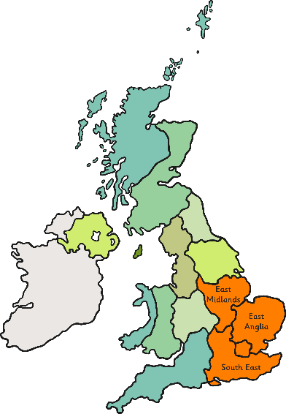
Where Do Tornadoes Happen?
America
Most tornadoes occur in Tornado Alley. (Texas, Oklahoma, Kansas, Nebraska, South Dakota, North Dakota, Iowa, Missouri, Arkansas and Louisiana)
More than 500 tornadoes are reported in Tornado Alley each year.
The UK
Most tornadoes occur in South East England, East Anglia and the East Midlands.
About 30 tornadoes per year are reported in the UK.
The UK has more tornadoes per unit of land than any other country in the world!

Slide 12
Aim
To explain what causes tornadoes and the effects they have.
Success Criteria
I can tell you how tornadoes form.
I can explain how scientists collect data about storms.
I can explain how scientists compare tornadoes.
I can tell you where tornadoes happen.

