Slide 1
Geography
Extreme Earth
Year One
Geography | Year 3 | Extreme Earth | More Volcanoes | Lesson 3

Slide 3
Aim
To explain how volcanoes affect people’s lives.
Success Criteria
I can tell you where volcanoes are found.
I can use extinct, dormant and active when describing volcanoes.
I can list the risks and benefits of living near to a volcano.

Slide 4
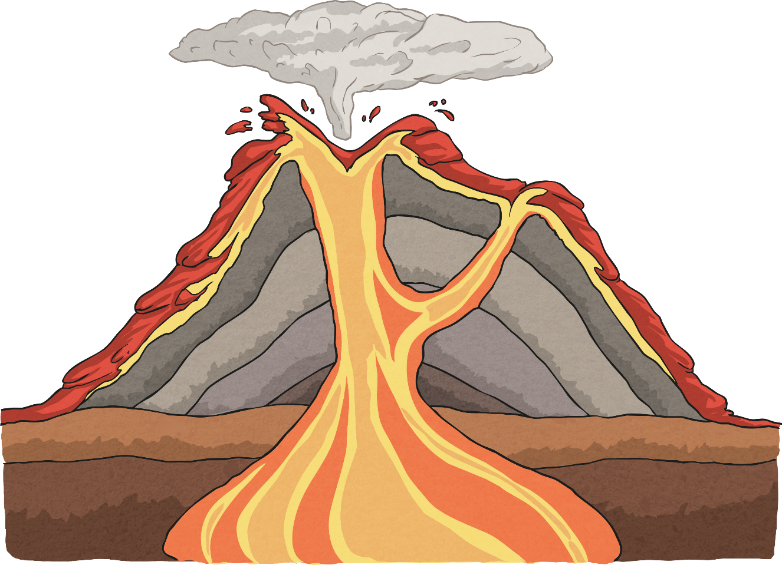
What’s It All Called?
Can you name the main parts of this volcano?
Can you explain how the grey layers were made?
eruption cloud
crater
conduit/main vent
magma chamber

Slide 5
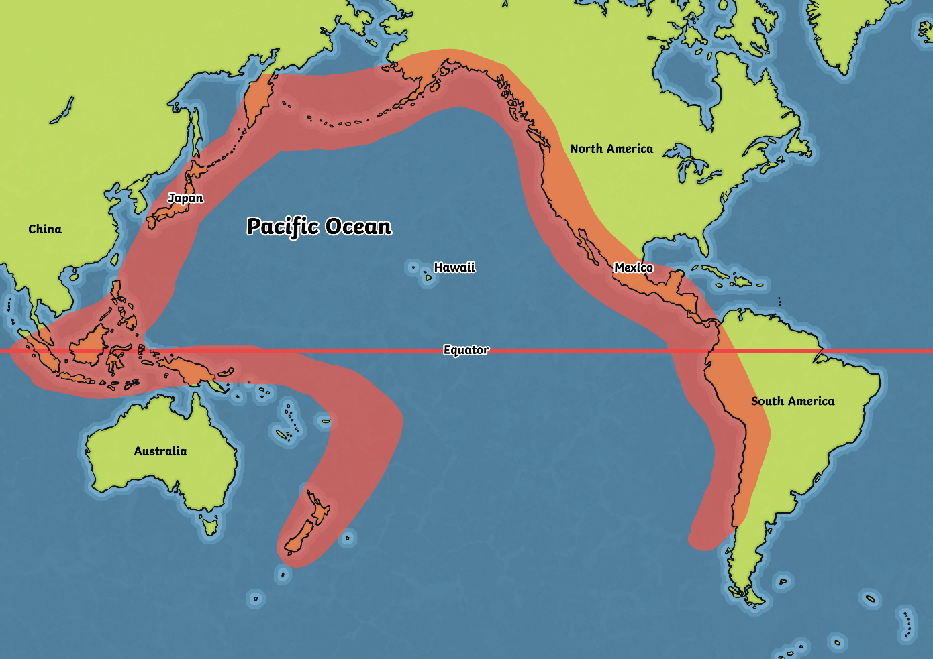
Where Are Most Volcanoes Located?
Look at this map.
Most volcanoes are located in the red area, which is named “Ring of Fire”.
Why do you think it is called that?

Slide 6
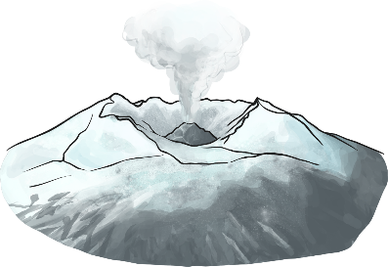
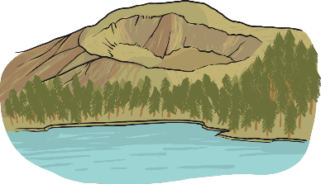
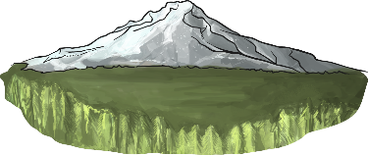
What Do They Mean?
active
A volcano that has erupted in the last 10 000 years.
dormant
A volcano that hasn’t erupted in the last 10 000 years, but may erupt again.
extinct
A volcano that hasn’t erupted in the last 10 000 years, and isn’t expected to erupt again.

Slide 7
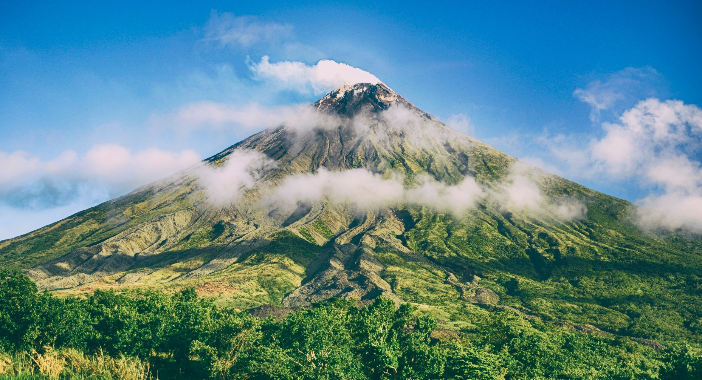
Would You Like to Live Near
These Volcanoes?

Slide 8
Would You Like to Live Near
These Volcanoes?
Photo courtesy of ierdnall @flickr.com) - granted under creative commons licence - attribution

Slide 9
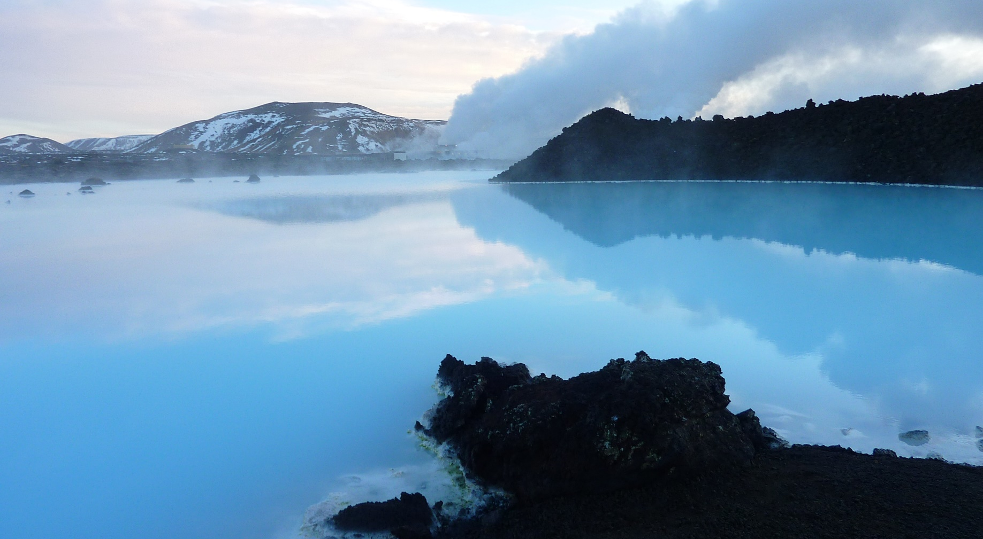
Would You Like to Live Near
These Volcanoes?

Slide 10
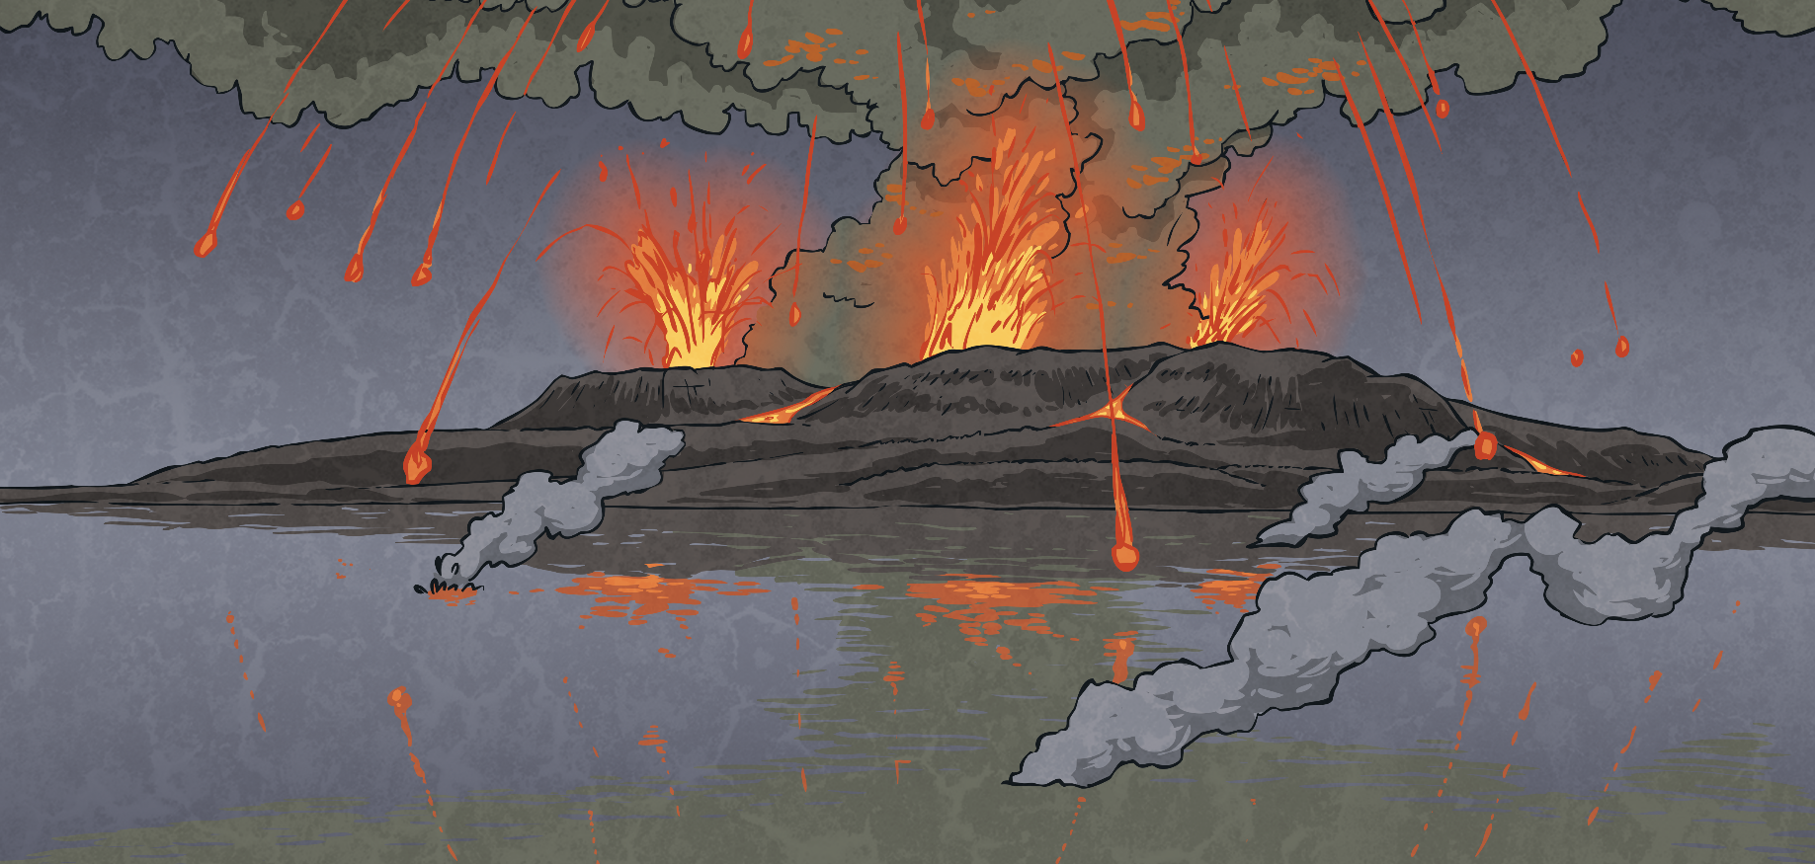
Why Do People Live
Near Volcanoes?
In your group, sort your cards into two piles:
For
Against
Which is the most important reason against?
Which is the most important reason for?
Do the risks seem worth taking?
Would you want to live near to a volcano?

Slide 11
Are There Any Volcanoes in the UK?
Arthur’s Seat, Edinburgh
Photo courtesy of [Duncan] @flickr.com) - granted under creative commons licence - attribution

Slide 12
Are There Any Volcanoes in the UK?
Bardon Hill Quarry, Leicestershire, England
Photo courtesy of MaltaGC (Own work) [CC BY-SA 3.0 (http://creativecommons.org/licenses/by-sa/3.0) via Wikimedia Commons

Slide 13
Are There Any Volcanoes in the UK?
Giant’s Causeway, Northern Ireland
Photo courtesy of TS Drown (@flickr.com) - granted under creative commons licence - attribution

Slide 14
Are There Any Volcanoes in the UK?
Snowdon, Wales
Photo courtesy of ...Like Clockwork (@flickr.com) - granted under creative commons licence - attribution

Slide 15
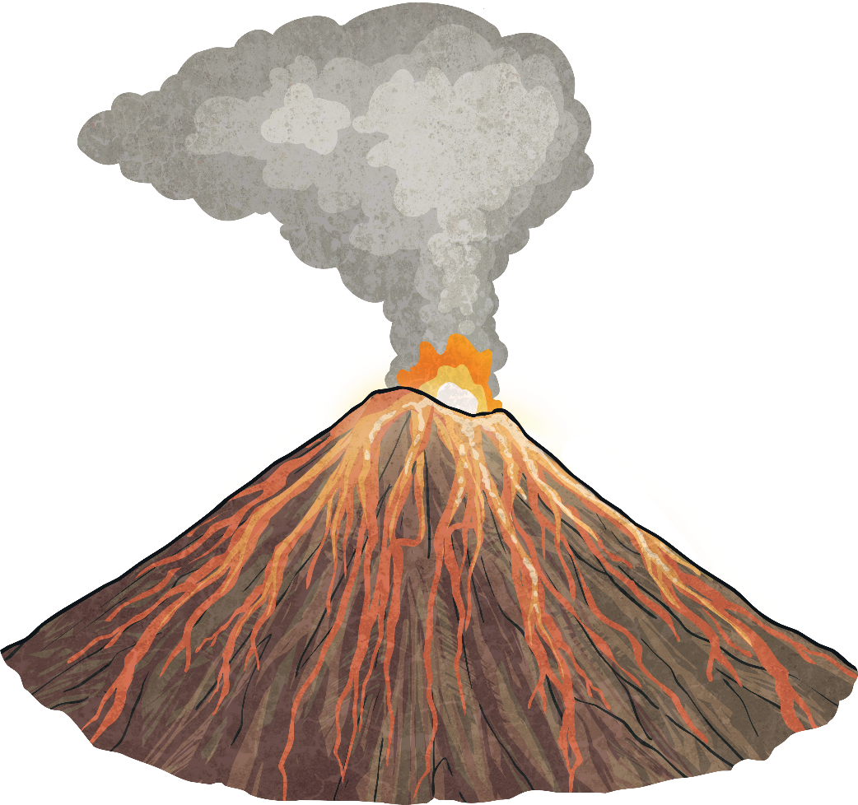
Are There Any Volcanoes in the UK?
Are these UK volcanoes active? Watch this video to find out!

Slide 16
Aim
To explain how volcanoes affect people’s lives.
Success Criteria
I can tell you where volcanoes are found.
I can use extinct, dormant and active when describing volcanoes.
I can list the risks and benefits of living near to a volcano.

